Slide 1
Methodology
Pick a sample of 267 placements from 20 accounts: 10 large, 5 medium and 5 small.
Count “served_tag_network” column in RedShift by: placement, date, network.
Run a similar query on kmn_cpm, and match the data.
Filter rows of less than 500 events.
Calculate a “deviation” metric for the difference in served (mysql vs. RS)
Predict deviation 1-day-ahead using moving average, testing window sizes of between 1 and 5 days.

Slide 2
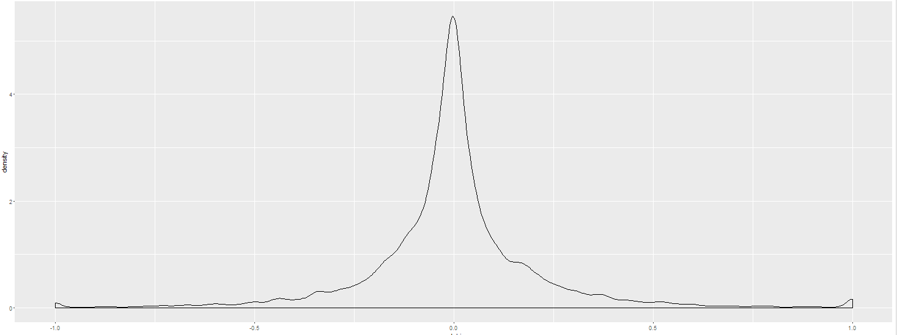
Result
Proposed model: 1-day moving-average of the deviation between served data in RS and in MySql.
Mean absolute prediction error on sample data: 13%.
A safety margin of 15% will result in 15% of cases over-estimated.
A safety margin of 20% will result in 10% of cases over-estimated.
Calculating safety margin per network may improve the result

Slide 3
eCPM prediction
eCPM prediction can be obtained in one of the following ways
Historical data from same tag
Historical data from same placement and network
Historical data from same network
Based on tag’s network and floor price
eCPM prediction in current code
Based on model per network per order
If model is missing, uses tag history, or similar network

Slide 4
Result
Ecpm prediction based on same tag at same floor price, when available
When not available, model should be based on tag’s floor price with a network-specific coefficient:
OpenX, 1.18
Index, 1.01
AOL, 0.90
Pubmatic, 0.99
PlusePoint, 1.00
Adx, 1.11

Slide 5
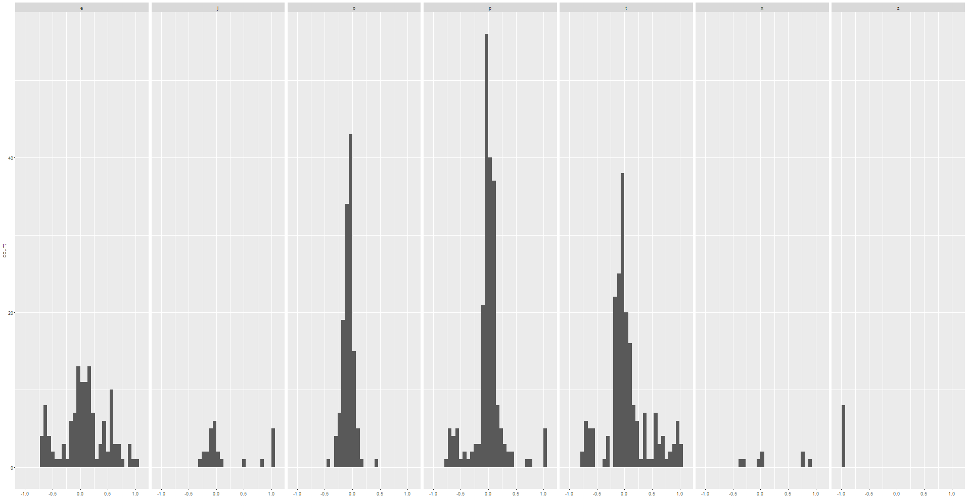
Deviation per network (count of rows with each deviation between -1 and 1)
OpenX
Index
AOL
Pubmatic
PulsePoint
Adx
Smaato
0’s in redshift
0’s in mysql

Slide 6
Important notes
For the dates 3/3 – 5/3, far fewer served events appeared in RS than actual number. This affected almost all placements and networks. “Representation rate” dropped on these days from around 90% to about 40%. These dates were ignored in the analysis presented in earlier slides.
AOL deviations have a similar pattern (deviation per day) across many placements from several users. This non-random effect should be investigated. See next slide.
Smaato deviation is -98%, i.e. less than 2% of served events are detected.
MySql data was substantially incomplete for both 13/3 and 14/3 (data was retrieved early afternoon on 15/3).

Slide 7
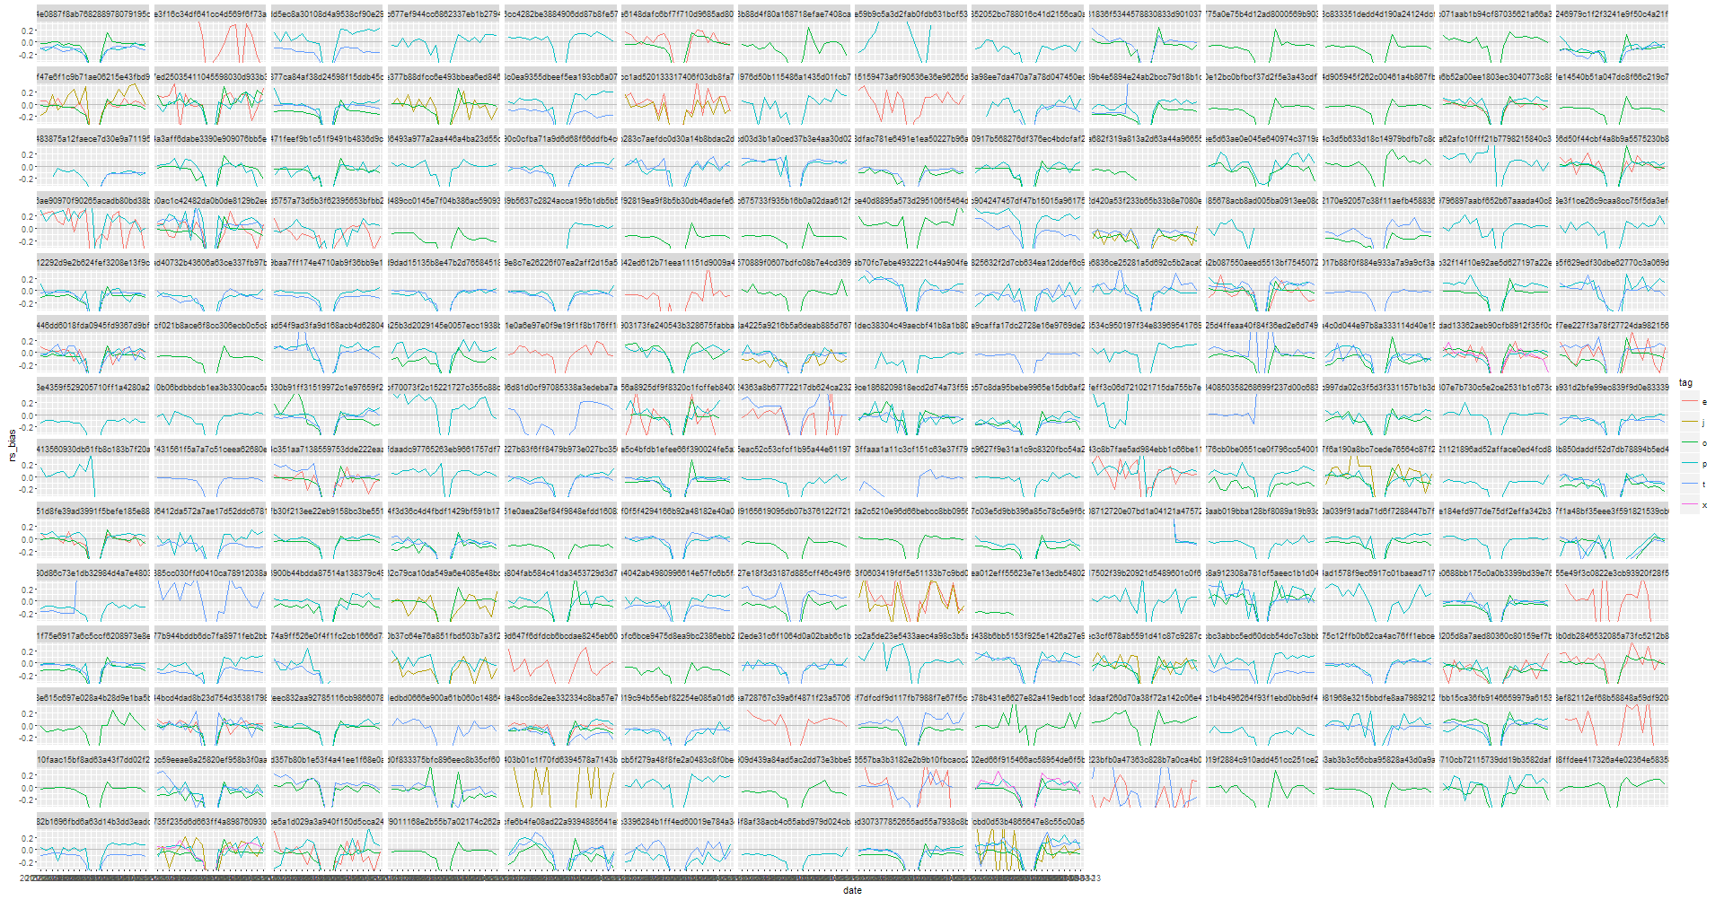
Deviation time-series: tile = placement, color=network. The “bad days” are the dip in the middle of each x-axis. Placements with similar AOL pattern are circled.

Slide 8
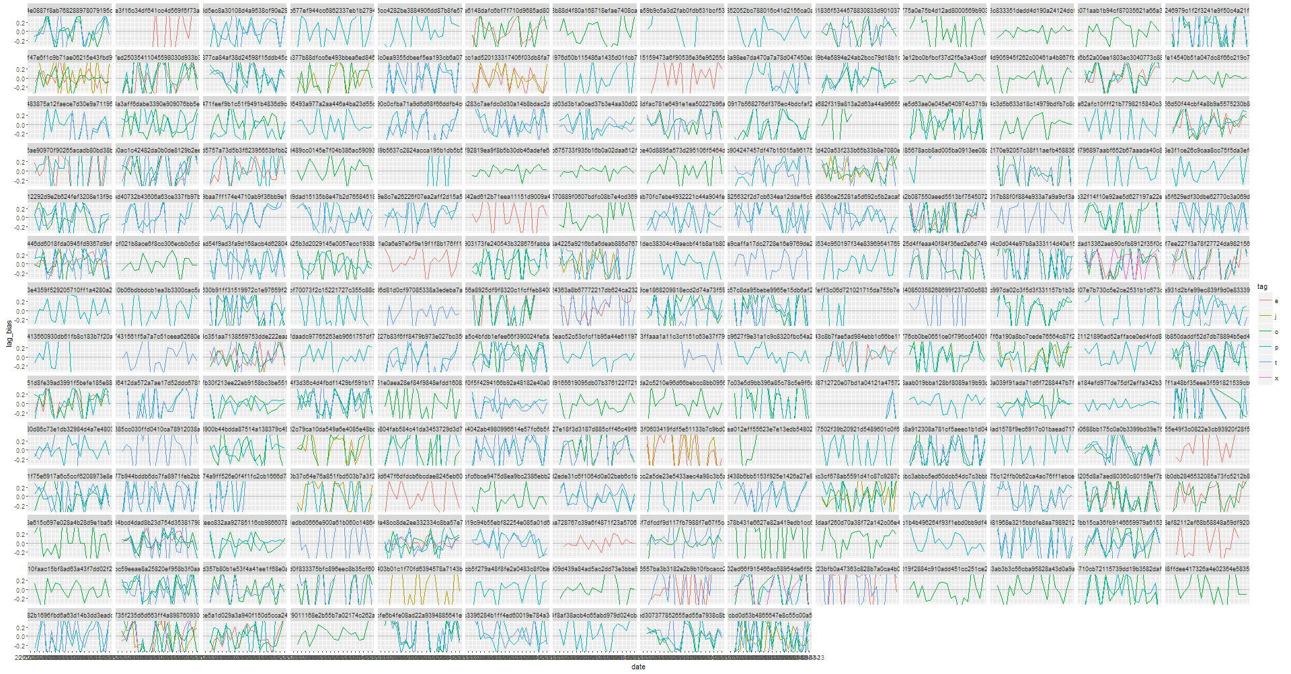
served day over day relative change: tile = placement, color=network

Slide 9
Technical details
RS rows:
Total: 25763
Served network == “h”: 5399
Served network blank: 5387 (21%)
--> Rows expected to be matched in mysql: 14977
RS rows unmatched by a corresponding MySql row: 999, most of them from 13/3 and 14/3 (data was collected on 15/3).
Rows from MySql with at least 10 served, but no matching RS data: 22 rows.
16 of them are smaato.
Average served count in these 22 unmatched rows: 97.

